Slide 1

Osric’s Office & Appliances
Test PLAN & PROTOTYPE
Mohammed Almuzel​​
Jason Lu​​
Marco Seman​​
Audrey White​​
Maricruz Zamora​
Martin Zanaj​​

Slide 2
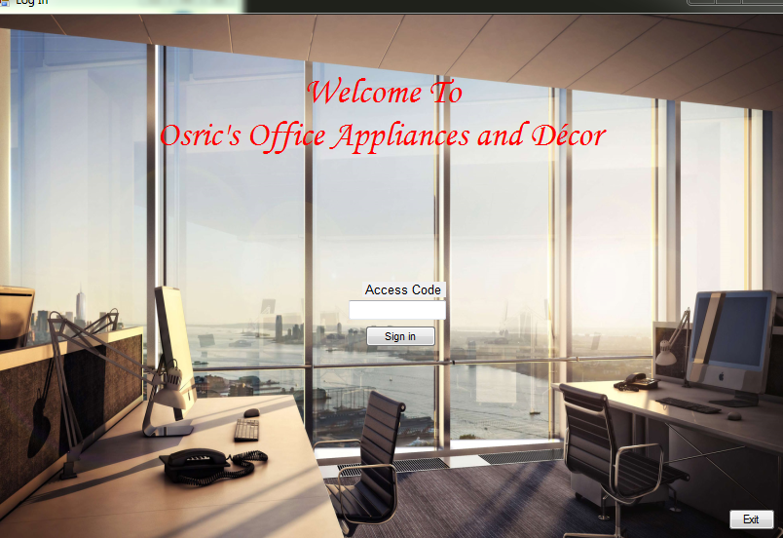
Prototype overview
Rapid prototype to be used by assistant.
GUI created with C# as a Windows Form Application.

Slide 3
Test plan
Four different types of test cases used:
Black Box – Working button event handlers that link back to proper screens.
Boundary – Valid textbox input for client forms.
Top-Down - All the rest of the button handlers function work and is checked by user logging in.
Unit Testing- Login access code allows user into program.

Slide 4
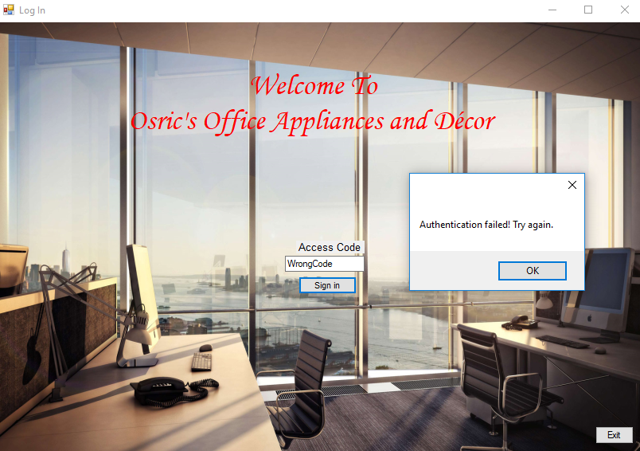
test case #1: Unit testing
If user enters wrong passcode, error window pops up.
User cannot successfully login without correct passcode.

Slide 5
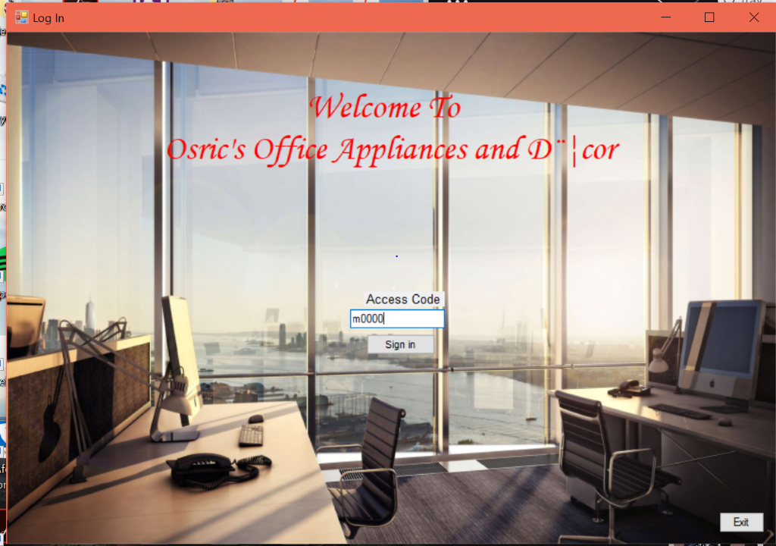
test case #2: Unit testing
User successfully logs in

Slide 6
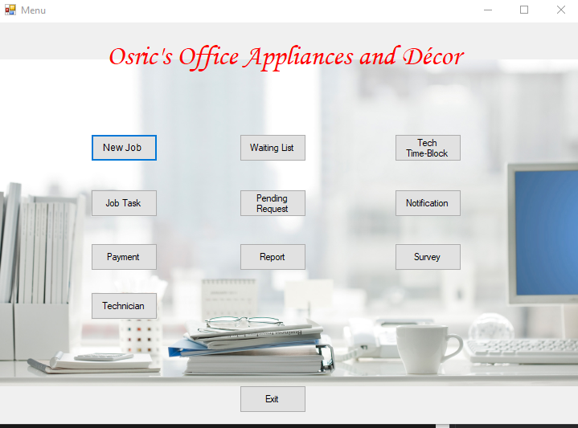

Result after logging in:

Slide 7
Test case #3: Black box Testing
All buttons in prototype return user to main menu.

Slide 8
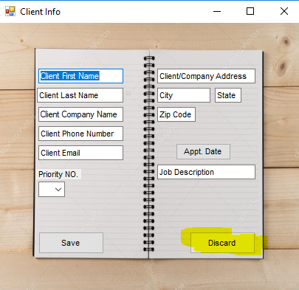
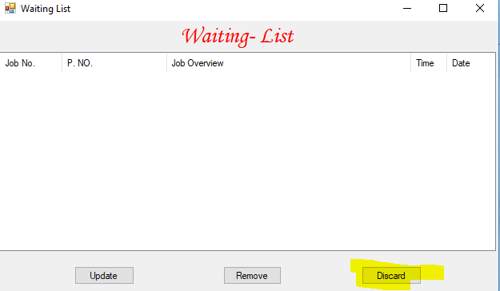
New task
Waiting list

Slide 9
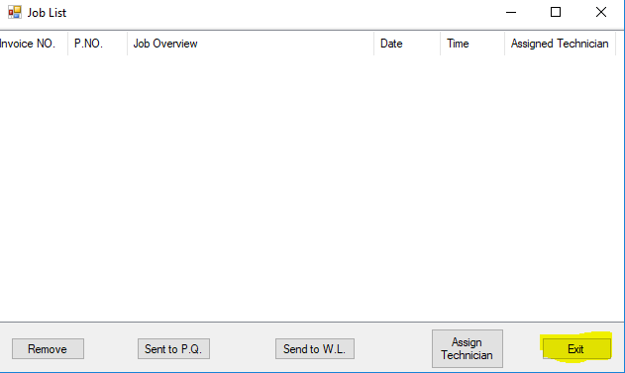
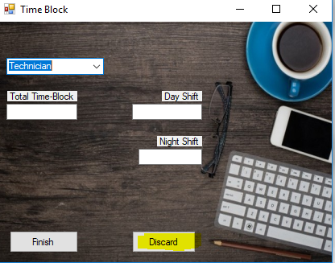
Tech time-block
Job List

Slide 10
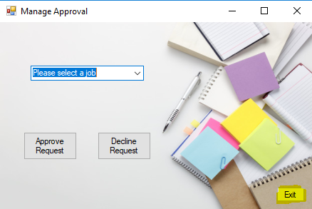
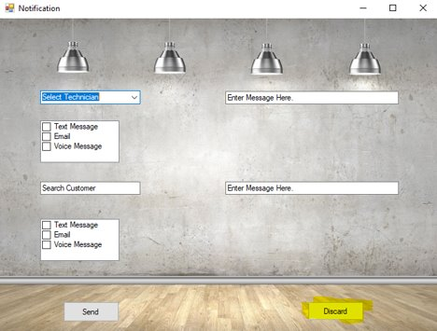
Manager approval Notification

Slide 11
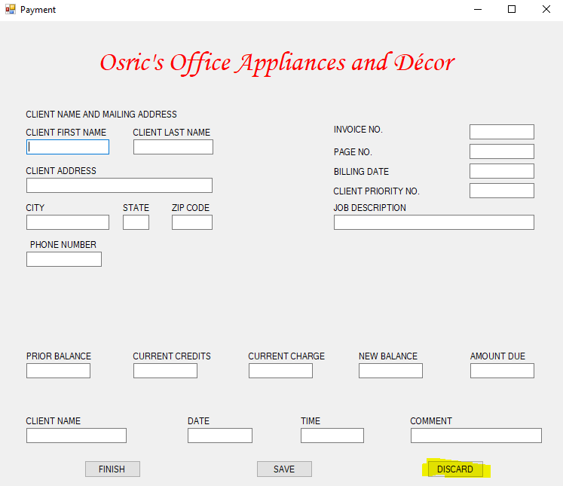
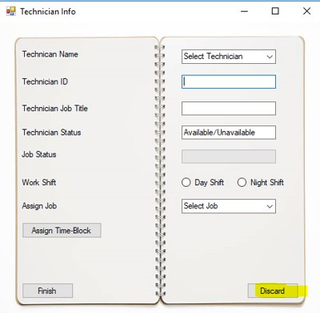
Payment
Technician Info

Slide 12
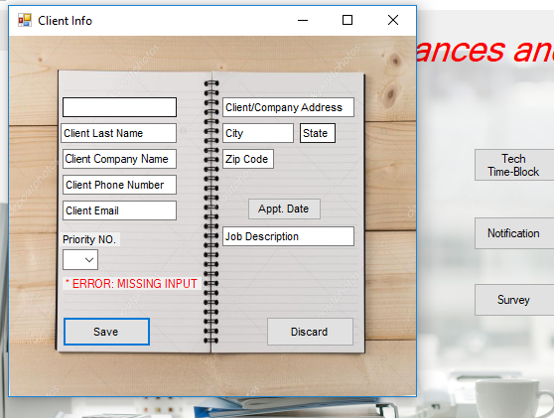
Test Case #4: Boundary testing
Blank Input- When user tries to save with any of the textboxes blank, an error pops up.

Slide 13
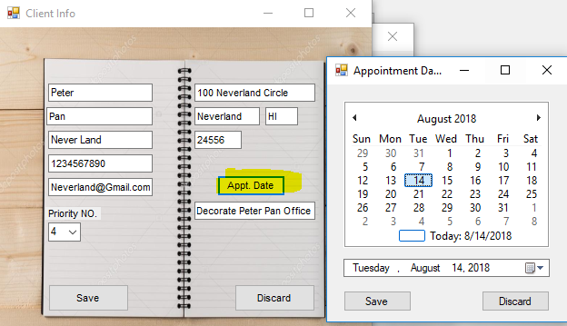
Test case #5: Top-Down testing (Testing every function)
New Job Appointment Date and Save Button

Slide 14
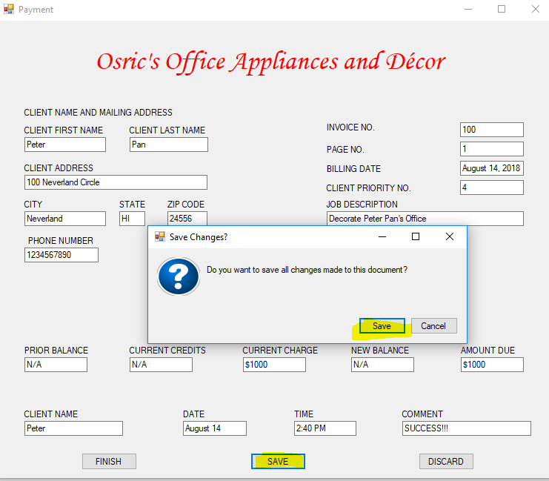
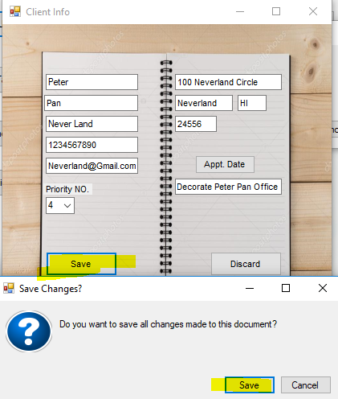
NEW JOB APPOINTMENT DATE SAVE BUTTON

Slide 15
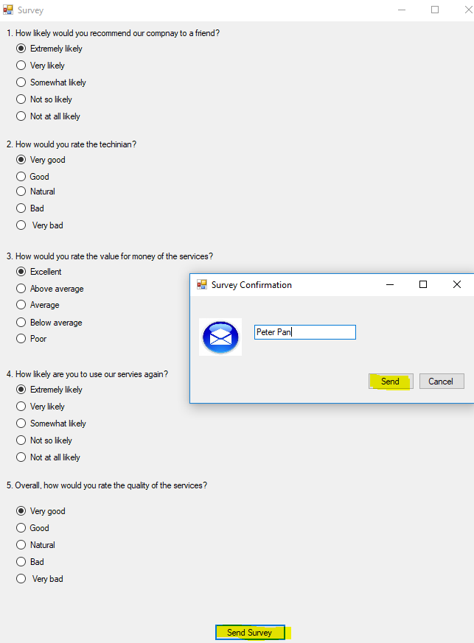
Payment save button send survey

Slide 16
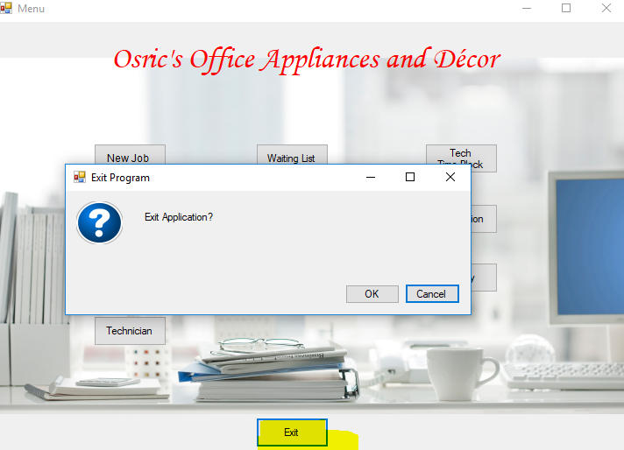
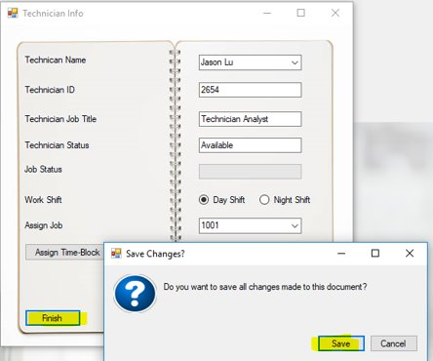
Exit application
Technician info

